Slide 1

GENERAL RULES FOR DESIGN
Prepared By:
Paras Kumar Chaudhary
Pratik Panuhar
Purushottam Thakur
Sachin Jha

Slide 2





Designing a Printed Circuit Board (PCB) is a crucial step in creating electronic devices. Proper PCB design is essential for ensuring functionality, reliability, and manufacturability of the final product. Here are some general rules and best practices to follow when designing a PCB:

Slide 3
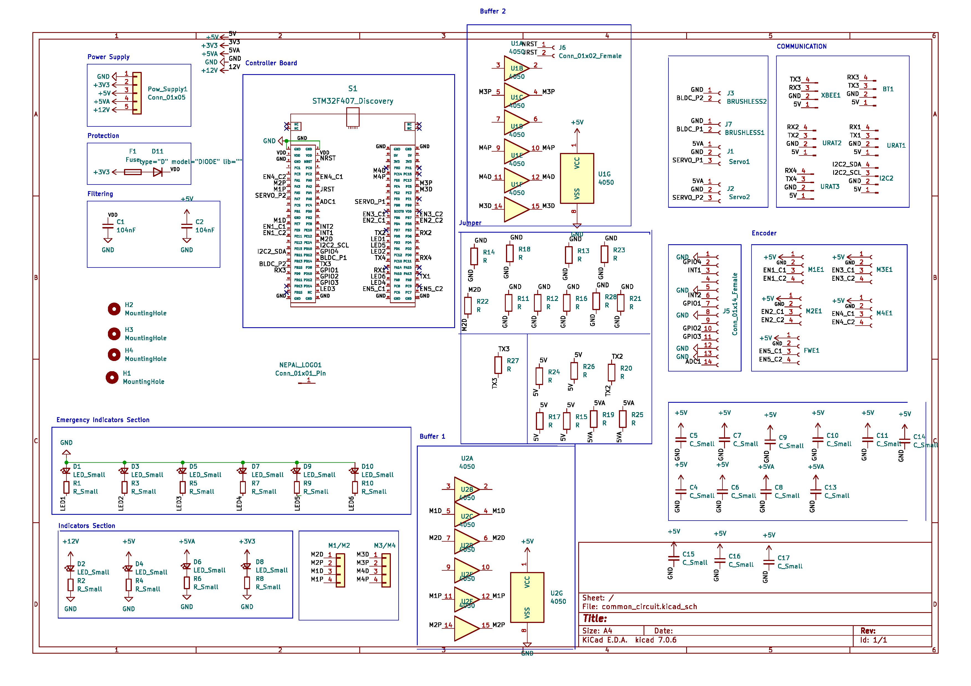
√
Plan Your Design

Slide 4
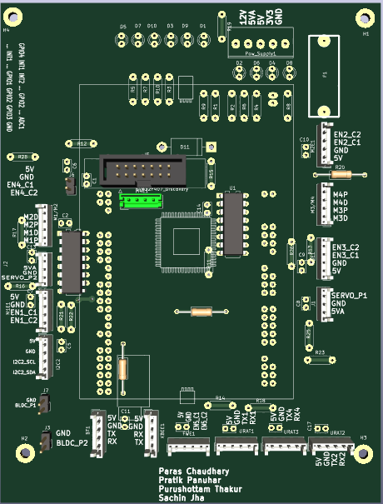
Component Placement

Slide 5
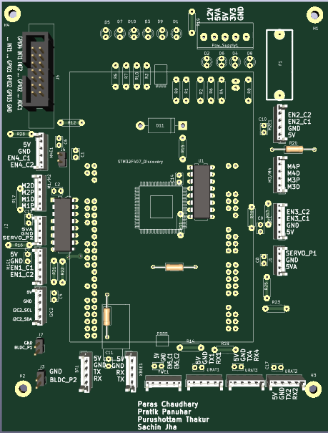
√
Component Placement

Slide 6
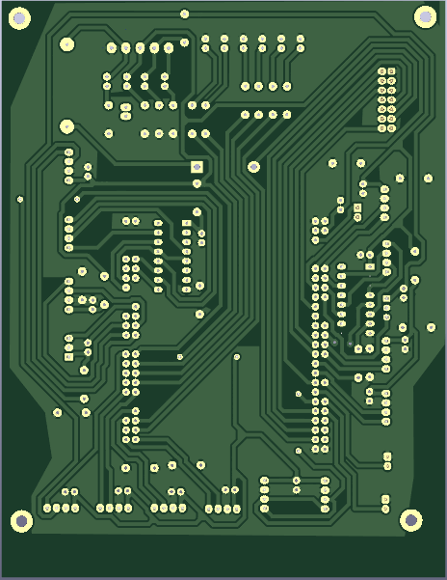
Reduce Grounding loops

Slide 7
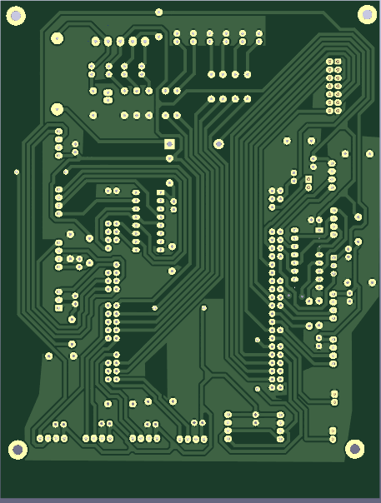
√
Reduce Grounding loops

Slide 8
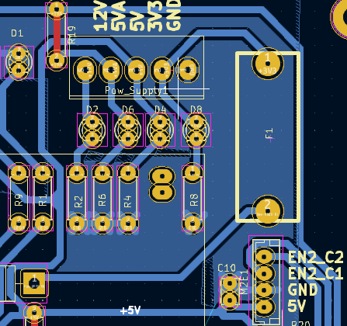
Decoupling Capacitor

Slide 9
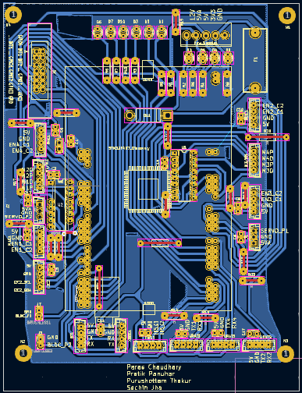
Short Traces
Figure: Short Traces and Daisy chain

Slide 10
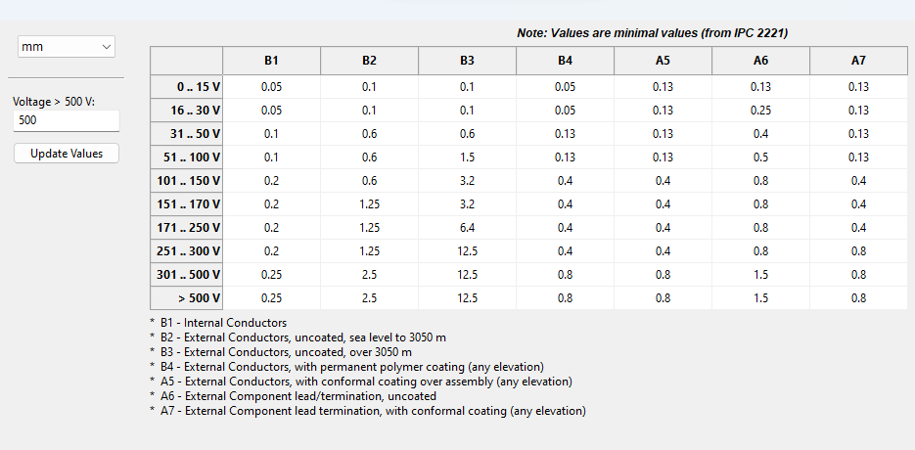
Maintain proper distance between two Traces (spacing)

Slide 11
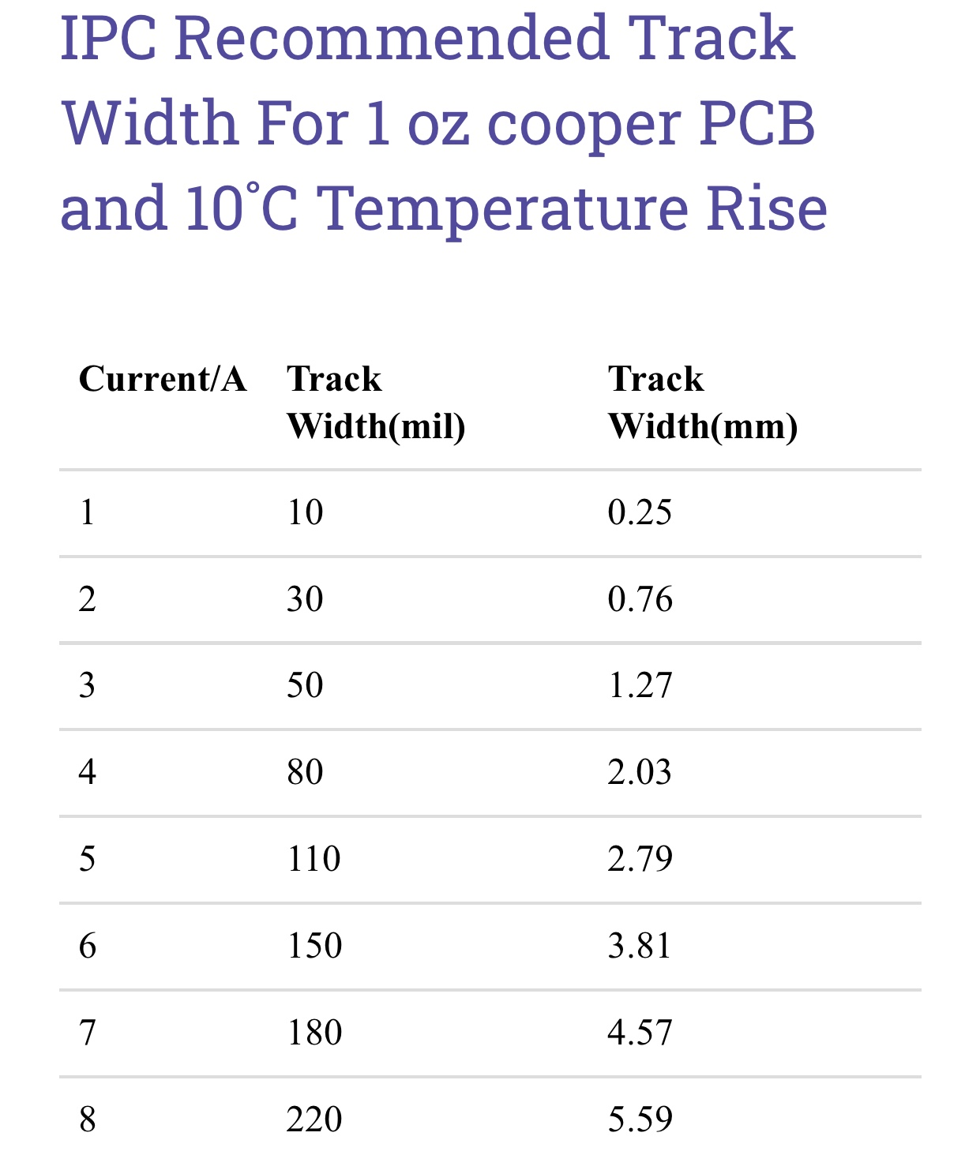
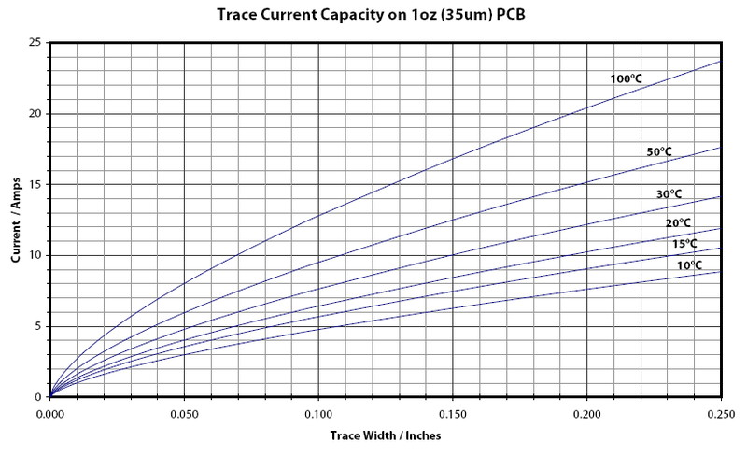
Table : List of Track width with different
Fig. : Graph between current v/s track width on different temperature

Slide 12
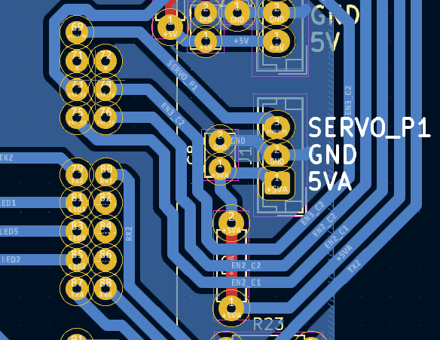
Isolating circuit with low current and low frequency from the circuit with high current and high frequency
High Frequency signal
Low Frequency signal

Slide 13
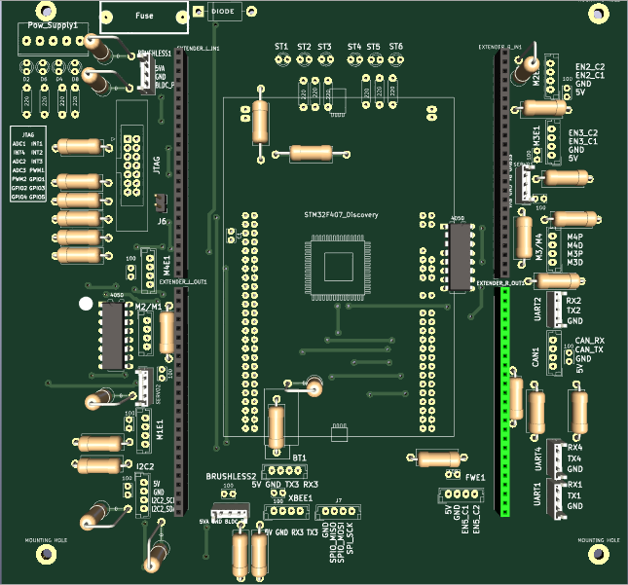
Test points

Slide 14
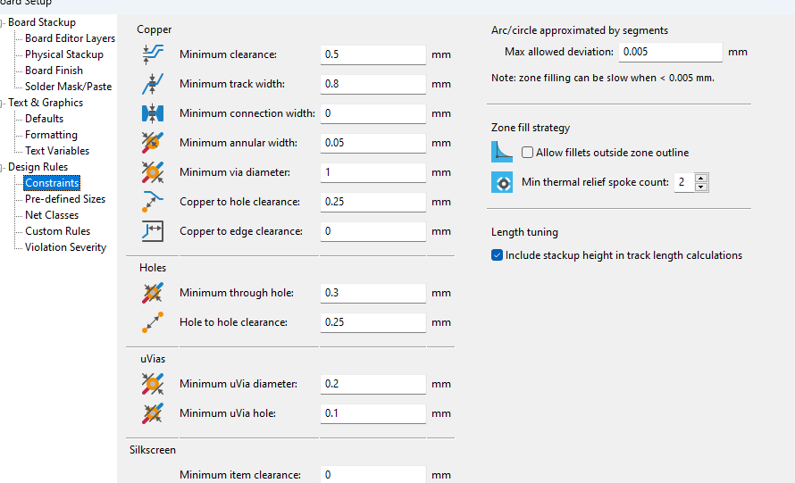
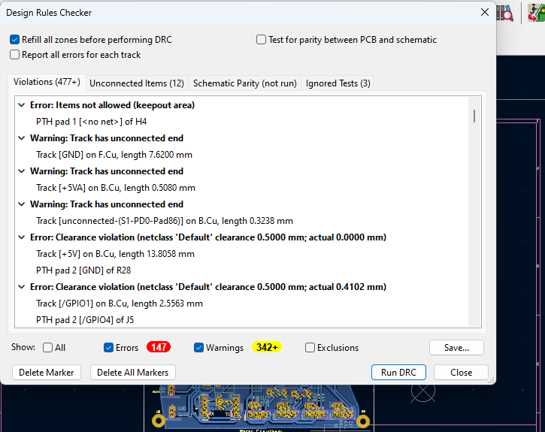
Check DRC error

Slide 15
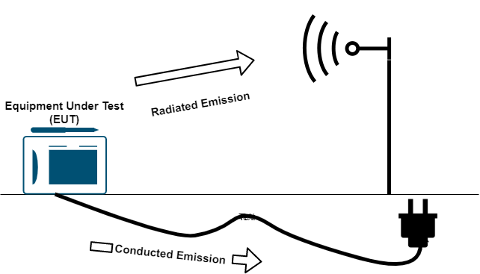
Electromagnetic Interference (EMI) Testing

Slide 16
Silkscreen and Reference Designators
The Silkscreen is the topmost layer of a Printed Circuit Board (PCB) which is used as a reference indicator for placing components on a PCB Board.

Slide 17
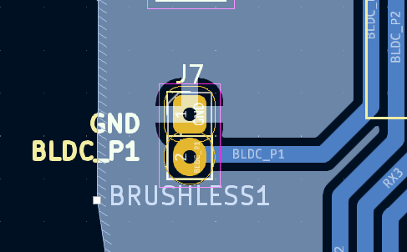
Thermal consideration
Thermal relief gap
Thermal spoke

Slide 18
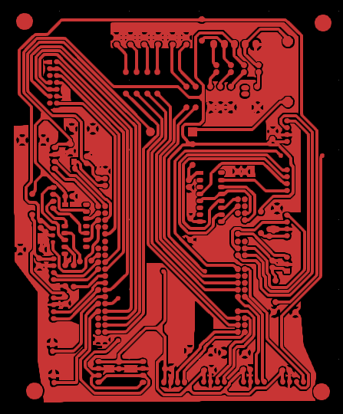
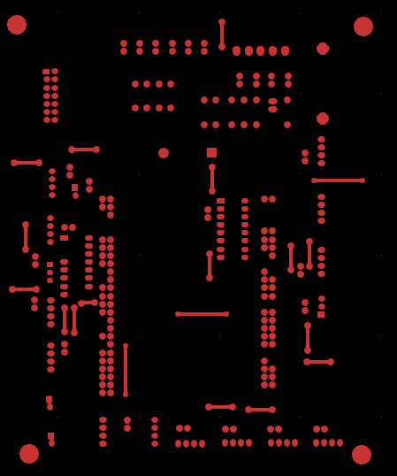
Plan Your Layout(Gerber file)
Back Copper
Front Copper

Slide 19

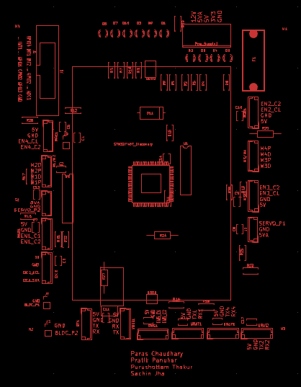

Front Silkscreen
Edge cuts

Slide 20

Thank You!

